Slide 1

9238-Mangayarkarasi college of Engineering (Approved by AICTE, New Delhi & Affiliated to Anna University, Chennai ) MANGAYARKARASI NAGAR,PARAVAI,MADURAI-625 402 Website: http://mce-madurai.ac.in E-Mail: mangai.enggcoll@gmail.com Phase-3 IOT-NOISE POLLUTION MONITORING
PROJECT TEAM MEMBERS
1.Aarthi Murugan(923821106001)
2.N.Aruna shree(923821106007)
3.K.Saranya(923821106045)
4.A.Sujitha Jasmine (923821106051)
5.S.Shabira(923821106049)
6.R.Priyadharshini(923821106037)
Project Guide ,
Mr.R.M.Senthilkumar,AP/ECE

Slide 2

Introduction
Noise exposure represents a major environmental issue and a burden on public health. The measurement and analysis of acoustic parameters through short-term and long-term noise monitoring is required for the identification of excessively noisy areas and planning for corresponding noise abatement measures or soundscape interventions. Major public health organizations such as the World Health Organization set up guidelines on maximum average noise exposure based on acoustic indicators such as Lden and Lnight. We present noisemonitor.A python package for short-term and long-term sound level monitor data analysis. The package allows for the calculation of acoustic indicators including average Laeq, Lden, LA10 or LA90 from short or long-term sound level monitor data in a few lines of code. In additions, it allows to compute and plot weekly and daily rolling averages to observe sound level trend and easily identify trends such as weekly public space use or recurring noise emissions. This python package could save time for professionals of the built environment by providing an easy-to-use tool for sound level monitor data analysis.

Slide 3
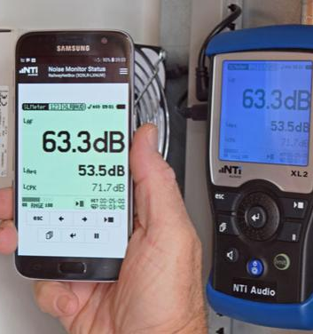
Noise Pollution Monitoring
Noise or sound level monitoring or measurement is a process to measure the magnitude of Noise in industries and residential area. Data collected from Noise level monitoring & Testing helps us to understand trends and action can be taken to reduce noise pollution. Noise pollution is Low or High-frequency sound that can cause/harm the activity of human life. It can be caused by various industrial Machines, Motor Vehicles and Craft etc. Noise Pollution Monitoring process is a part of Environmental Monitoring & Testing as noise pollution is also increasing exponentially in recent years.

Slide 4
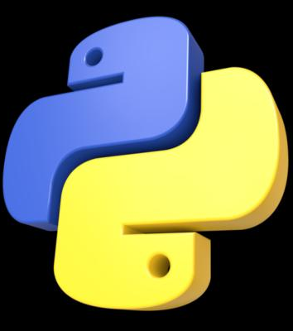
Python
Python is an interpreted, object-oriented, high-level programming language with dynamic semantics. Its high-level built in data structures, combined with dynamic typing and dynamic binding, make it very attractive for Rapid Application Development, as well as for use as a scripting or glue language to connect existing components together. Python’s simple, easy to learn syntax emphasizes readability and therefore reduces the cost of program maintenance. Python supports modules and packages, which encourages program modularity and code reuse. The Python interpreter and the extensive standard library are available in source or binary form without charge for all major platforms, and can be freely distributed.

Slide 5
Python Program
Import machine import network from machine import Pin import urequests import time # Connect to Wi-Fi def connect_to_wifi(): ssid = "YOUR_WIFI_SSID" password = "YOUR_WIFI_PASSWORD" station = network.WLAN(network.STA_IF) if not station.isconnected():

Slide 6
print("Connecting to WiFi…") station.active(True) station.connect(ssid, password) while not station.isconnected(): pass print("Connected to WiFi:", station.ifconfig()) # IR Sensor Setup ir_sensor_pin = 14 # GPIO pin where the IR sensor is connected ir_sensor = Pin(ir_sensor_pin, Pin.IN) # Server URL to send IR sensor data server_url = http://example.com/ir_data

Slide 7
# Main function def main(): connect_to_wifi() while True: ir_value = ir_sensor.value() # Read IR sensor value (0 or 1) print("IR Sensor Value:", ir_value) # Send IR sensor data to the server try: response = urequests.post(server_url, json={"ir_value": ir_value}) print("Server Response:", response.text) response.close()

Slide 8
except Exception as e: print("Error:", e) time.sleep(1) # Wait for 1 second before reading again if __name__ == "__main__": main()
The provided python program is designed for an ESP8266 based to monitor noise level using a sensor and send that data to ThinkSpeak, a cloud – based IoT platform .

Slide 9
Conclusion
This Python Program for the ESP8266 offers a Practical way to setup the noise pollution Monitoring system for Tracking noise level. By Sending this Data to ThinkSpeak, you can Visualize and analyze it over time. You can further expand on this project by adding more sensors, implementing additional features, or integrating it with other IoT Platforms or Services or more Comprehensive noise pollution monitoring in residential areas or other Locations.

